Slide 1
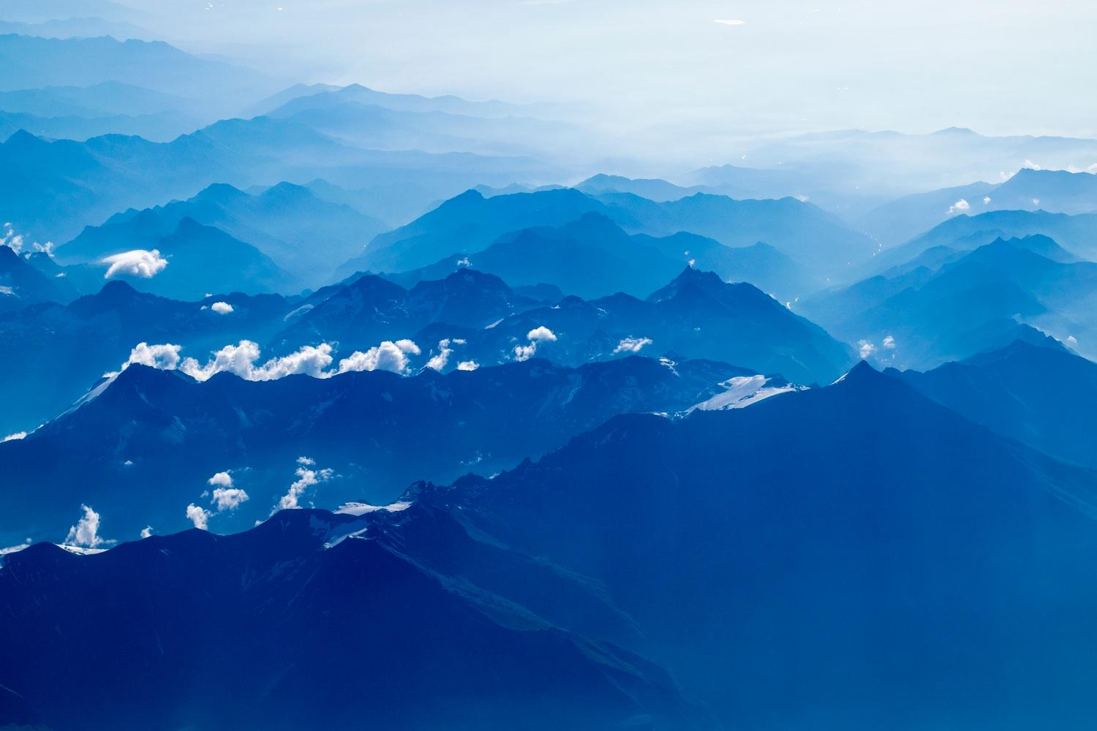
Procedural city generation using Perlin noise
Notes:
Procedural city generation using Perlin noise

Slide 2

Welcome!
Presented by:
Niclas Olsson
Elias Frank
Notes:
Present ourselves

Slide 3
Introduction
1
Motivation and summary
Notes:
This will be in the introduction:
Motivation of work
Motivation of Perlin noise
Video

Slide 4
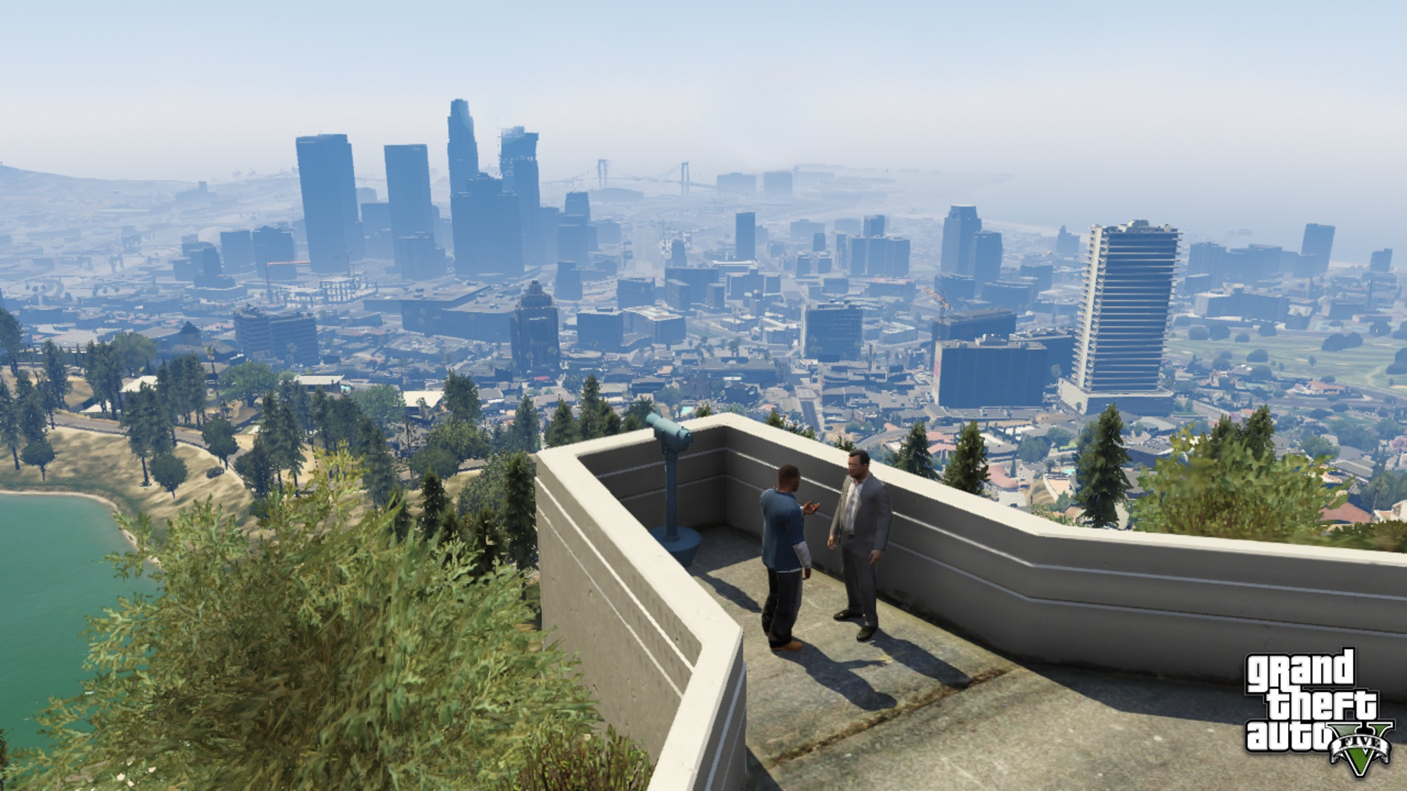
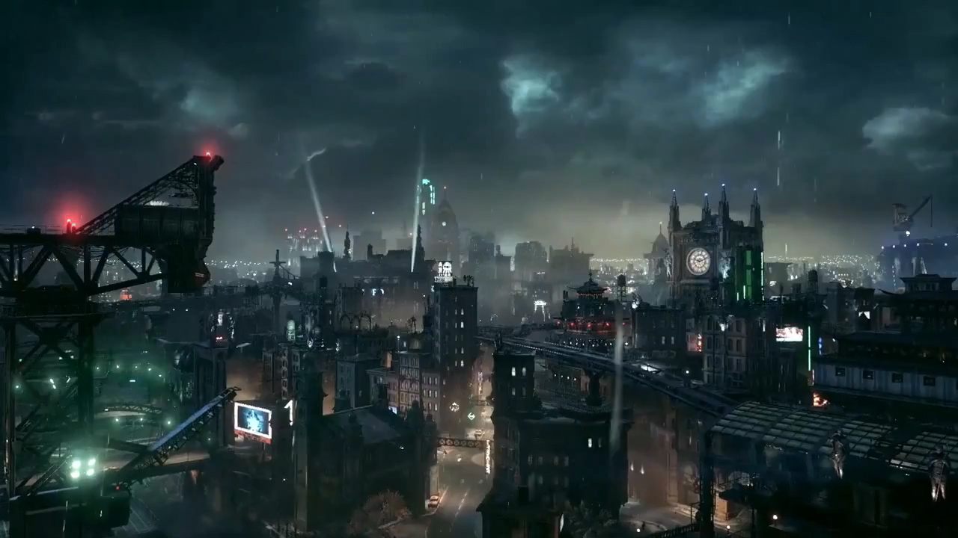
Successful games
GTA V
Batman Arkham city
Notes:
GTA V budget 137 million $
Estimated 4-5 years
More than 1000 developers during that time
Batman Arkham city
At least 2 years
https://en.wikipedia.org/wiki/Development_of_Grand_Theft_Auto_V
https://www.gamespot.com/articles/rockstar-more-than-1000-people-made-gtav/1100-6415330/

Slide 5
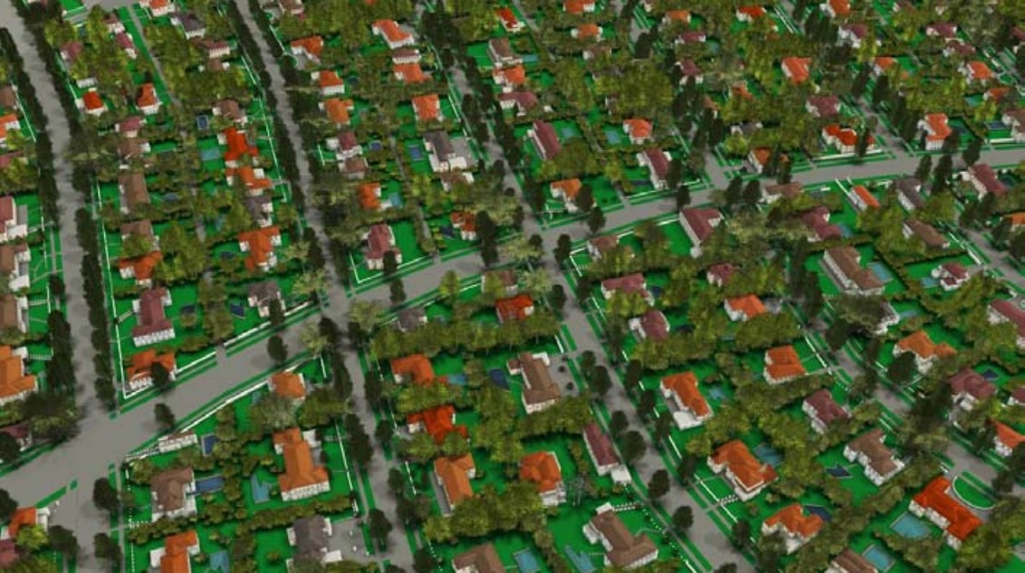
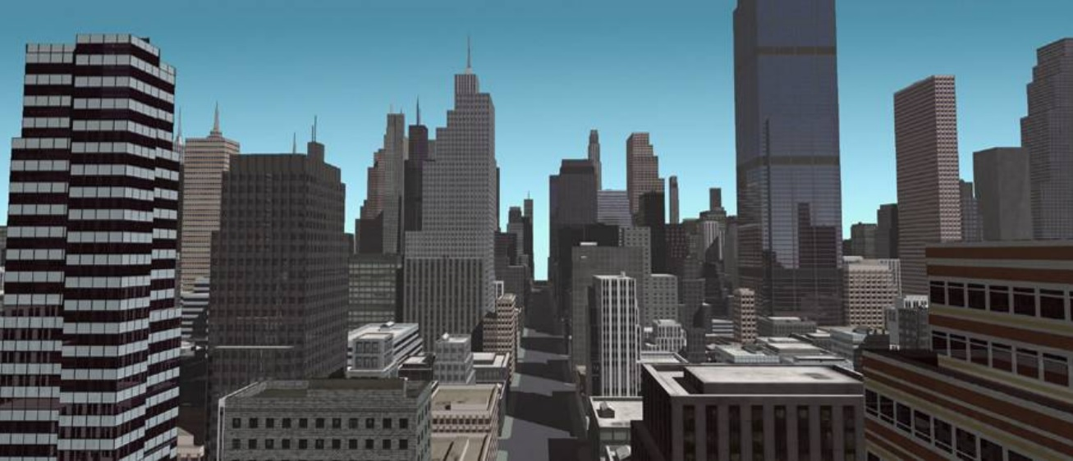
Procedural generation
L-System
CGA – Shape Grammar
Notes:
Procedural modeling of cities part vi
L-System
CGA – Shape Grammar
97.000 lines of code
6 man years of work

Slide 6
Hand crafting vs Procedural generation
Time
Money
Small companies
Notes:
Why procedural?
Making content cost:
Time
Money
Small companies
PCG helps with content creation
No mans sky 18 quintillion planets
Borderlands over 17 million guns
Small companies can create lots of content

Slide 7
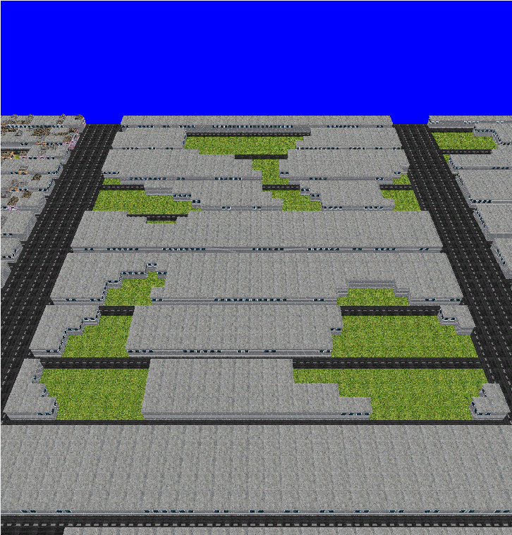
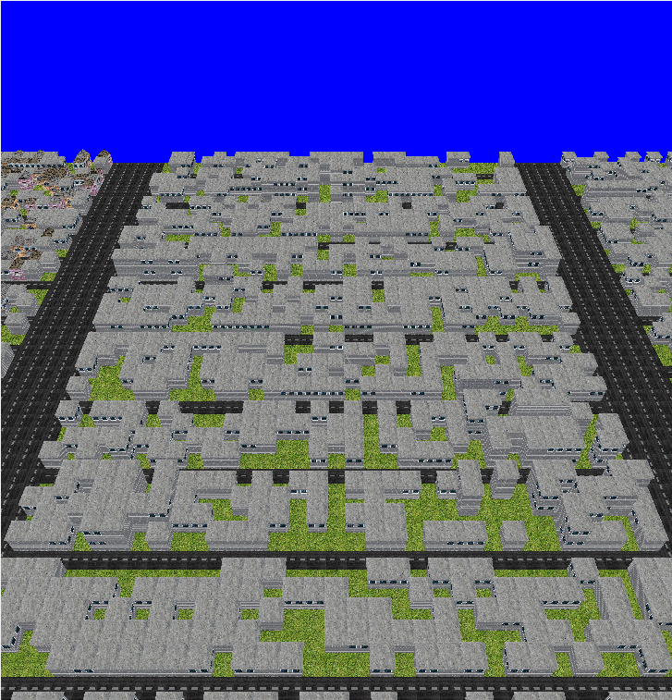
Why Perlin noise?
More natural shapes?
Documentation
Implementation
Notes:
Top Perlin noise
Bot random
Which is more natural?
Fast to implement
3 days vs 6 man years
Perlin noise:
Famous
A lot of documentation

Slide 8
Video of implementation
Try to notice what is happening.
Interface
Changing of parameters
Notes:
Video
Right – Parameters and seed
Left – Data from generated city
Middle – graphical interface
Things to notice:
Different seeds
Height of buildings
Building density, grass

Slide 9
Method
2
Implementation and evaluation
Notes:
This will be in the method:
Briefly explain Perlin noise
Explain PCG pipeline
-Districts
-Blocks
-Buildings
Explain user study:
-Questionnaire
-Images
-Motivate

Slide 10

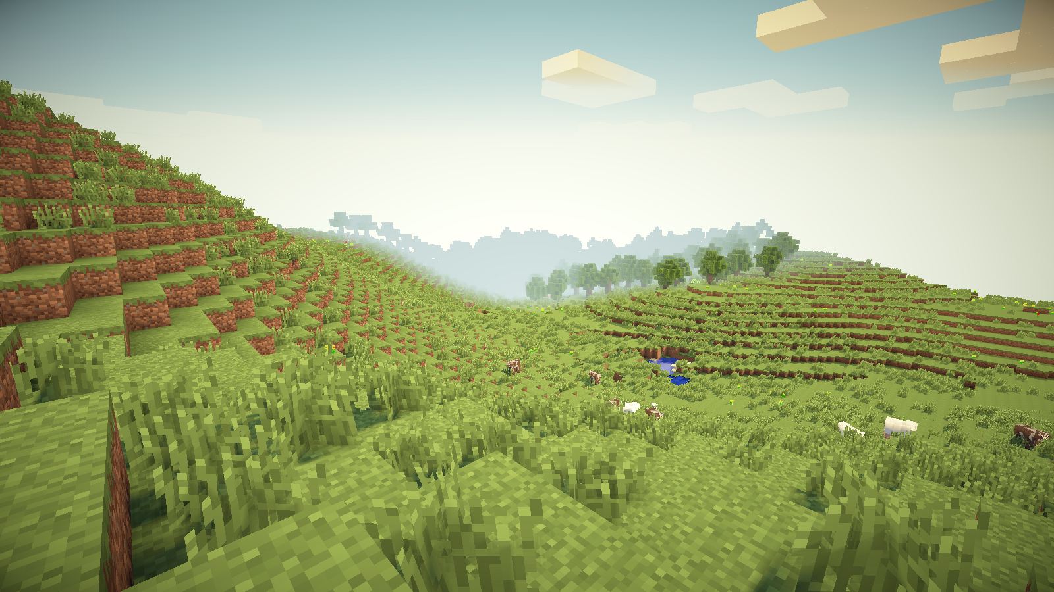
Perlin noise
Developed by Ken Perlin in 1984
Improved in 2001
Common in PCG
Notes:
Ken Perlin used it for textures in movies, won award.
Top image is of typical Perlin noise.
Bottom image is Minecraft, using Perlin noise for the terrain.

Slide 11
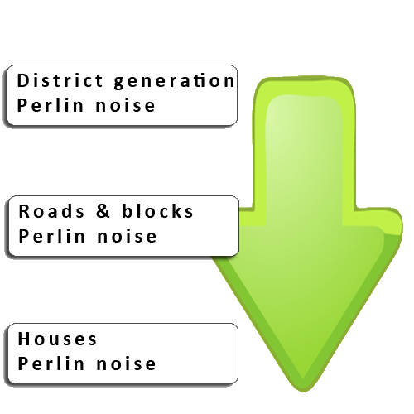
PCG pipeline
Top-down
-Districts
-Blocks
-Buildings
Notes:
Pipeline is top-down: every step depends on the previous
Every step uses Perlin noise
Intermediate format is a 2D-array

Slide 12
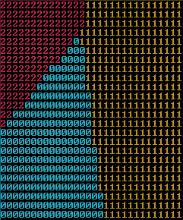
Districts
Cell
Core position
Euclidean distance
Border control
Depends on:
Seed
Notes:
Cells could be a house or a road
Core position with modified Perlin noise
Euclidian distance, closest wins cell
Border control
Perlin noise
30% control length

Slide 13
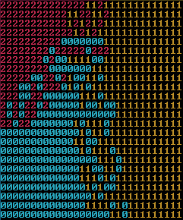
Districts
Core position
Euclidean distance
Border control
Depends on:
Seed
Notes:
Cells could be a house or a road
Core position with modified Perlin noise
Euclidian distance, closest wins cell
Border control
Perlin noise
30% control length

Slide 14
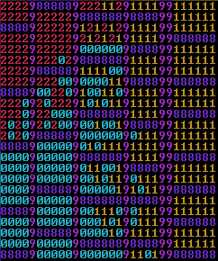
Blocks
Main roads first
Small roads second
Depends on:
Block size
Notes:
Generate main roads first. Main roads run all the way through the city. Walk the grid horizontally. (pink 9s)
Fill the gaps between main roads with smaller roads. Walk the gaps vertically. (purple 8s)
Creates blocks.

Slide 15
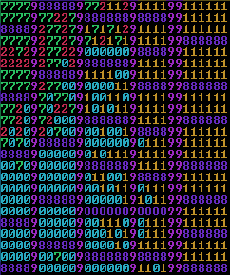
Buildings
Determine building or vacant
Generate building
Depends on:
Min/Max height
Building sections
Notes:
Uses Perlin to determine if we should place a building or leave it vacant (green 7)
When generating a building, take into consideration the building sections of the district
Also take into consideration the min and max height of the district

Slide 16
User Study
Evaluation of the implementation.
Notes:
We evaluated the viability of the implementation through a user study.
The reasoning behind the user study was to show participants images of generated cities and let them determine if they think the cities are viable to be used in games.

Slide 17
Questionnaire
1. How often do you play games?
2. Which city looks most random?
3. Which city looks most natural?
4. Which city looks least natural?
5. Which city (if any) could be used in a game?
6. Which city looks the most repetitive?
7. Which city looks the prettiest?
8. Which city looks the ugliest?
9. Which city has the best road network?
Notes:
This was the questionnaire used in the user study. We will show the results a little later on.
The idea behind the first question was to determine if familiarity with games would bias the answers to the questions.
Unfortunately, a majority of the participants was from the same group, which shows some selection bias.
From these questions we wanted to determine the impact that our pipeline had on the result.
The most notable question is number 5, which directly correlates to our research question.

Slide 18
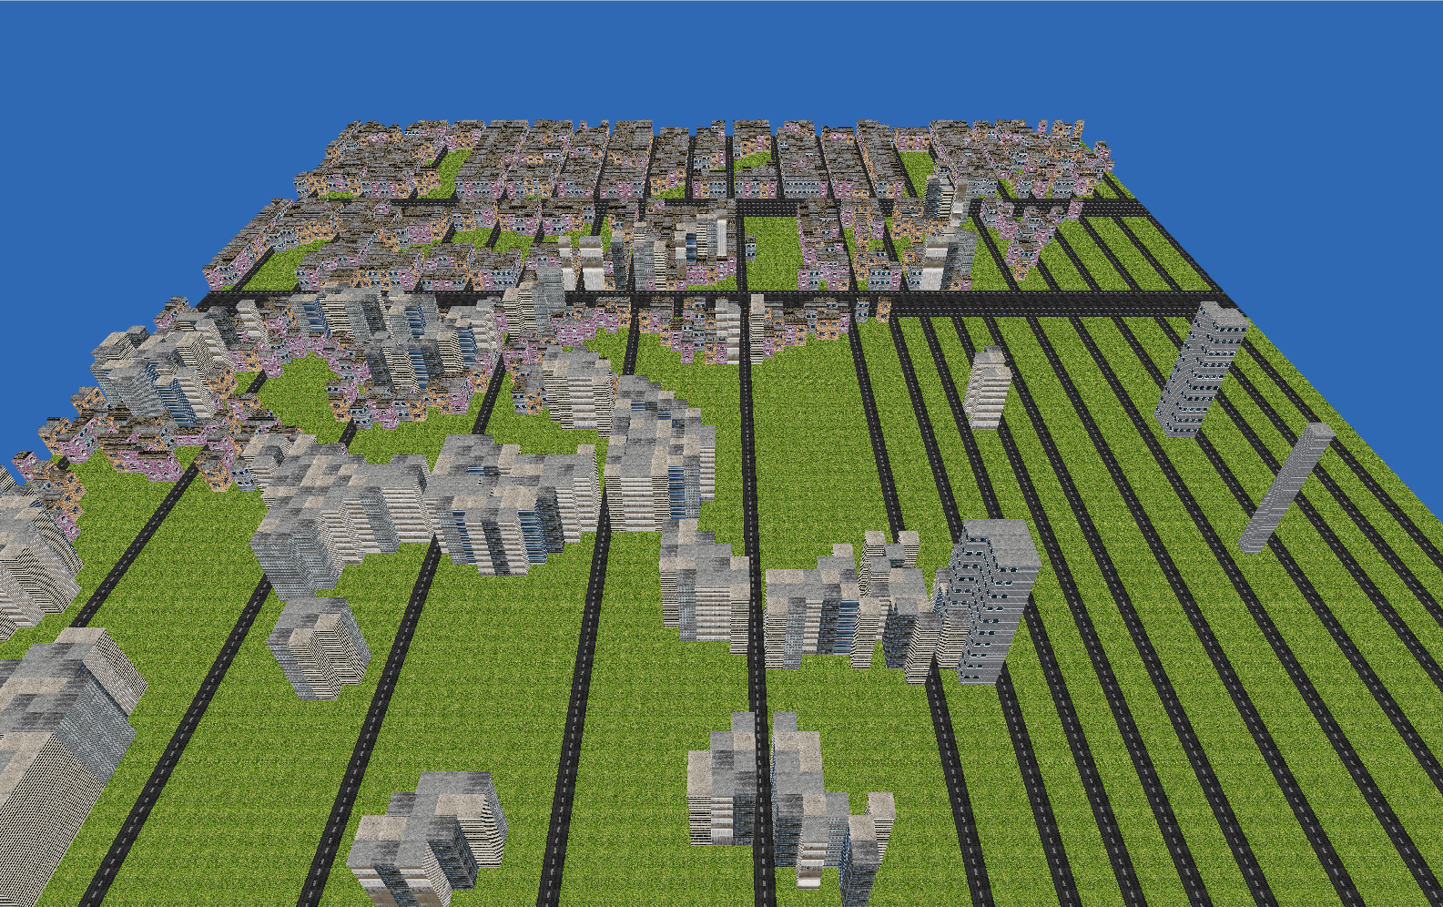
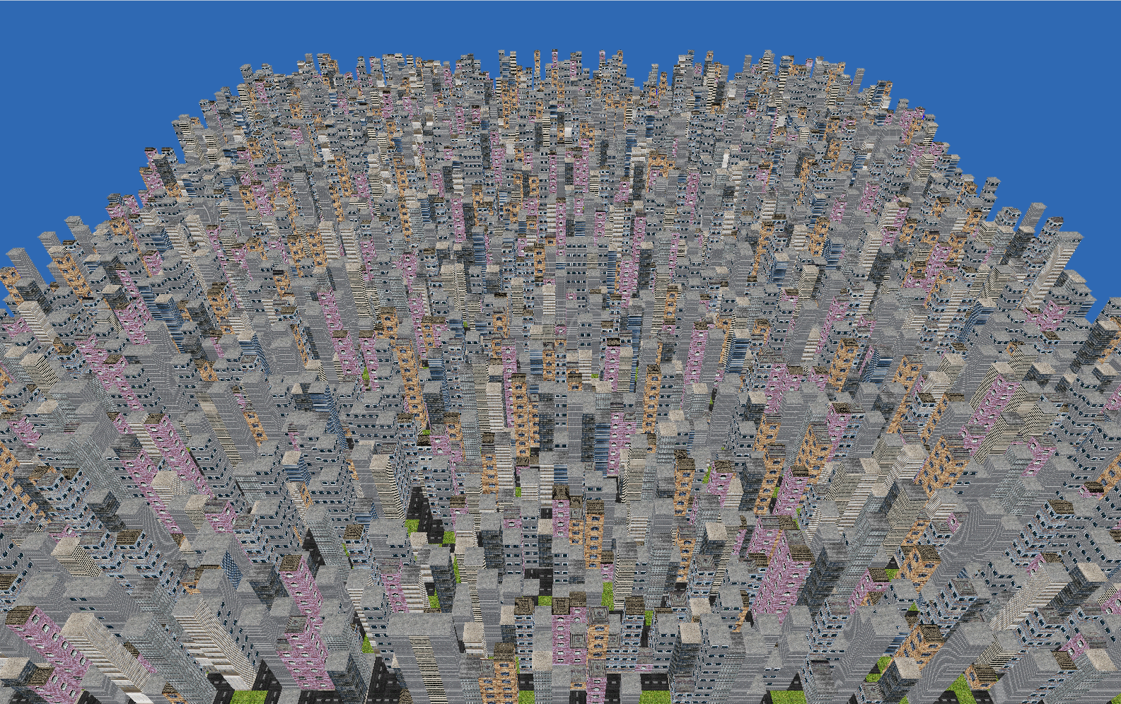
Notes:
Top-left: Bad parameters
Bottom-right: Full random (using rand)

Slide 19
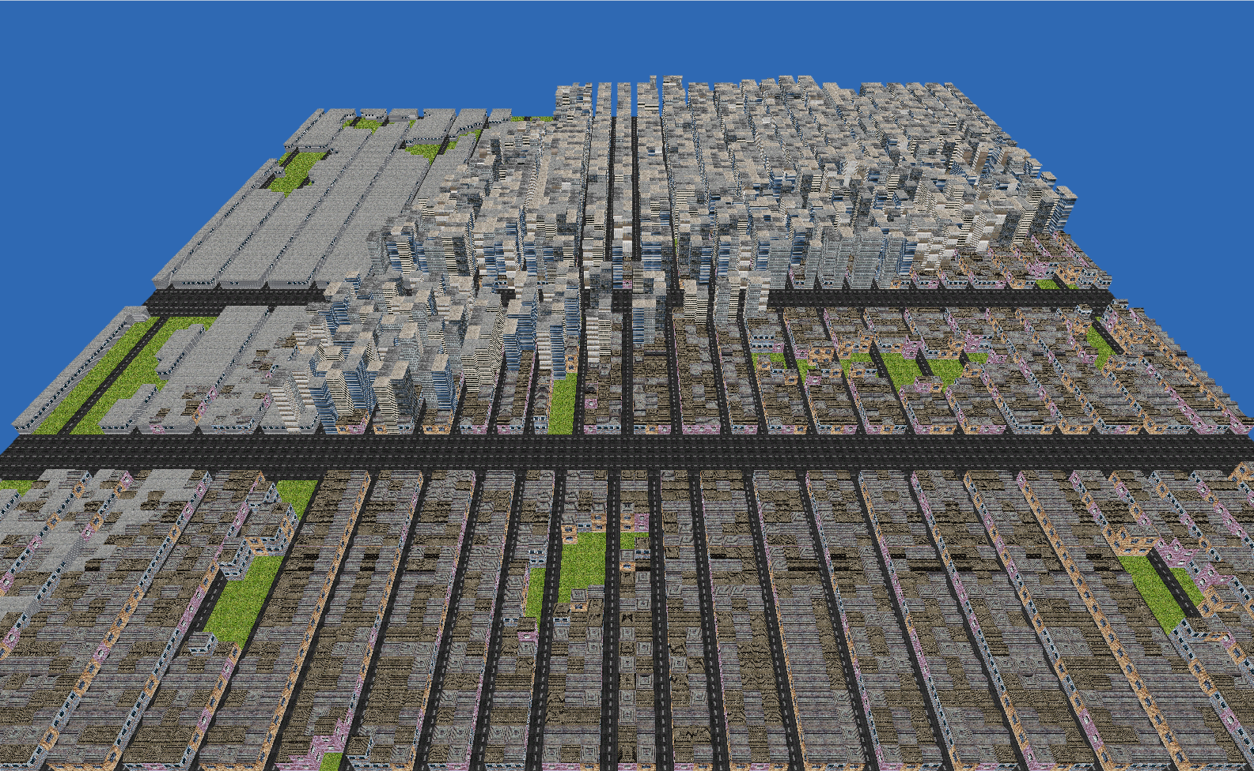
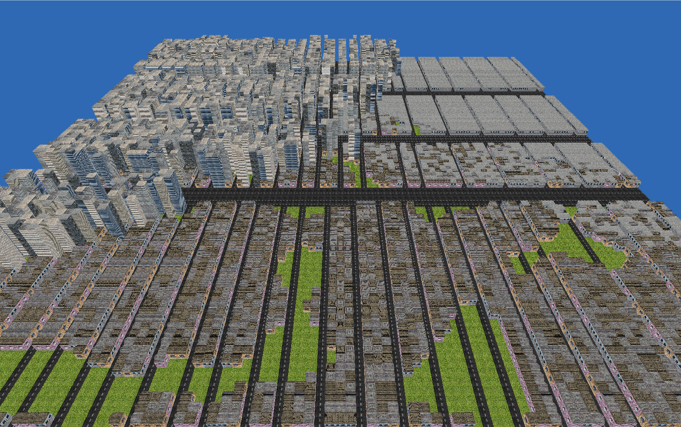
Notes:
Two cities with good parameters

Slide 20
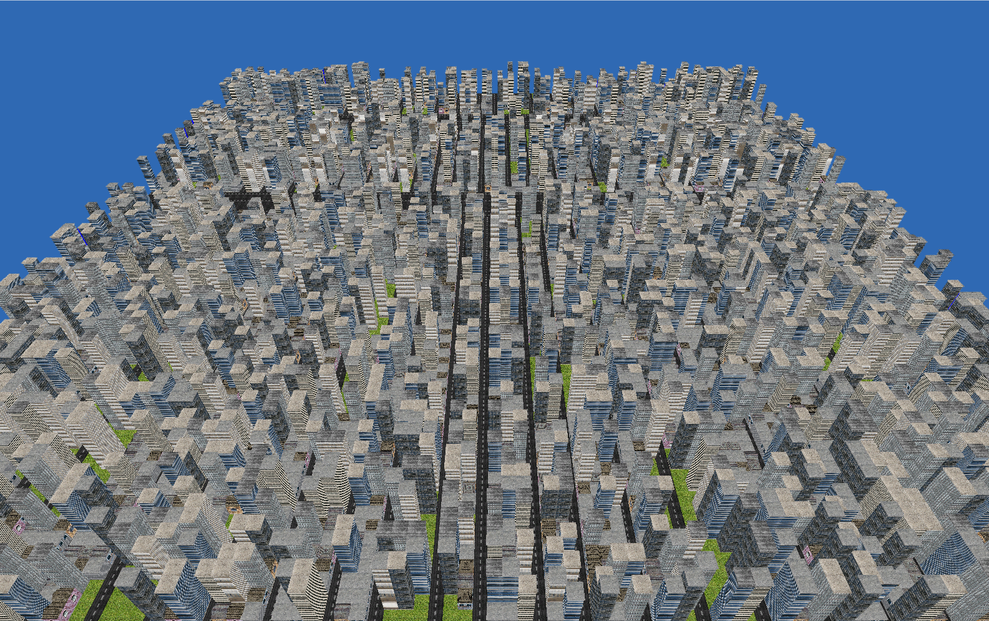
Notes:
Random districts (using rand)
Note: They were not shown in this order during the user study.
The images were printed out on seperate A4-papers and labeled with numbers.

Slide 21
Results
3
User study and performance data
Notes:
This will be in the results:
User study results
Performance results
Compare Random vs PCG
Viability

Slide 22
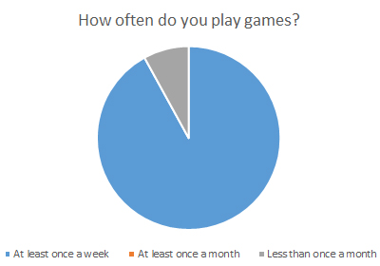
Notes:
Different groups – different opinions?
Participants
25 at least once a week
2 less than once a month
Removed small group
All results from gamers

Slide 23
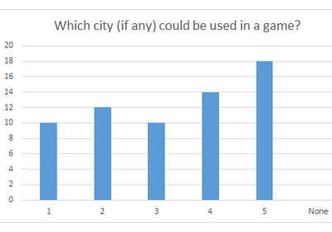
Notes:
Measure viability
No one picked ”none”
All seem to be viable
Least viable
Most viable

Slide 24
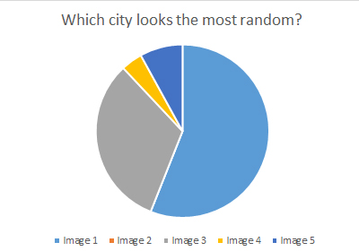
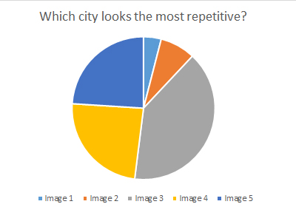
Notes:
Measure differences of random and procedural
Bad parameters
1 looks most random
3 looks most repetitive
But it is most random

Slide 25
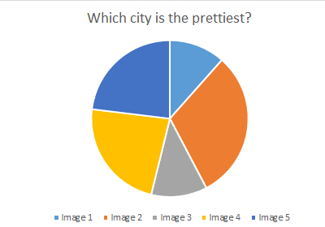
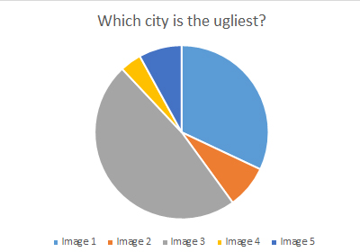
Notes:
Compare viability to looks
No clear winner
2,4,5 most liked
1,3 disliked
Least viable is also the ugliest
Most viable not prettiest

Slide 26
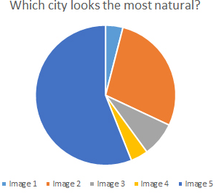
City 5 – Random districts
Notes:
Measure: Is districts natural?
5 most natural
Districts bad?
Better districts?

Slide 27
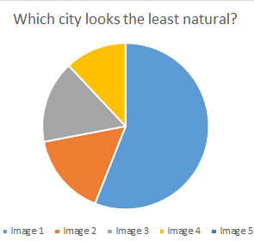
City 1 – Bad parameters
Notes:
Measure: Is districts natural?
PCG – parameters important
Improvements?
More meshes
Different results?

Slide 28
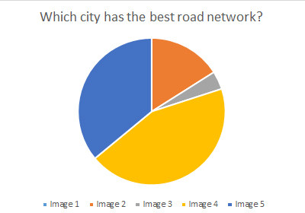
City 4 – Good parameters
Notes:
Best road network
City 4
Better than city 2
Similar parameters, different results

Slide 29
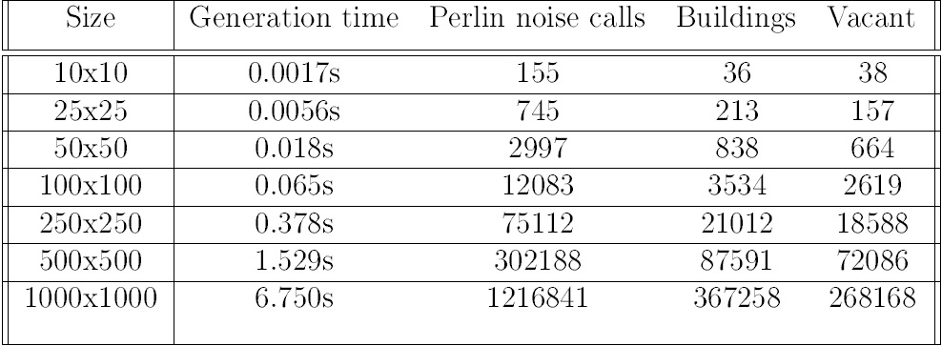
Performance Data
Notes:
Performance Data
100 random generations
Average numbers
100 cells – 2 ms
Viable in games
On the fly generation and rendering of infinite cities on the gpu
Culling
Optimization
Caching
GPU

Slide 30
Discussion
4
Notes:
Talk about weak points in the project and how it may have affected the results

Slide 31
Pipeline
Impact of districts?
Perception of randomness?
Impact of assets?
Notes:
Pipeline is: Districts -> Blocks -> Buildings
Most people liked the city in the image, which has random districts
How much impact did the districts have?
We limited the number of districts to 3, we don’t know if more districts work or not
The user study asked participants about randomness. Maybe our perception of randomness differs from theirs. Maybe some randomness looks natural
Did the models and texture impact the look of the districts?
Leads me on to the next slide

Slide 32
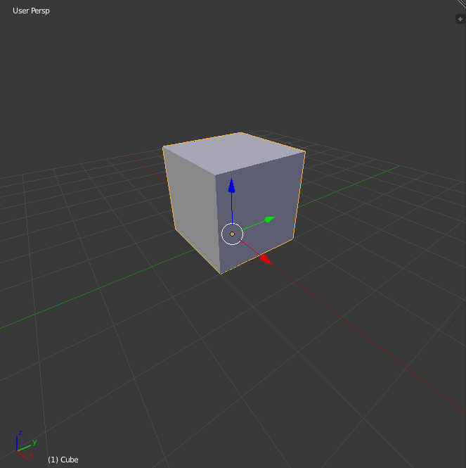
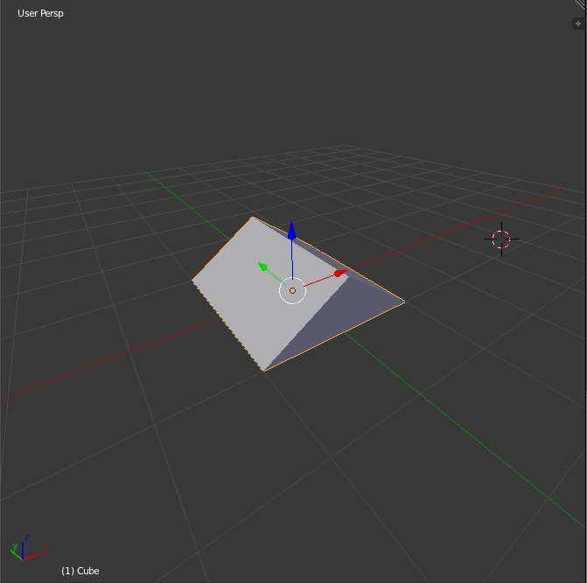
Assets
Low quality models and textures
Time constraint
Impact on the user study?
Notes:
Used low quality assets like the ones in the images
Using basic shapes were one of our constraints for the project, would take too long to make nice ones
Better looking models and textures impact the look of the city? Impact the user study?

Slide 33
Conclusion
4
Concluding thoughts and future work
Notes:
Summarize the project and provide pointers to future work

Slide 34
Conclusion
Application created
Perlin noise used
Evaluation through user study
Conclusive results
Notes:
An application was created
That uses Perlin noise in a top-down pipeline
Cities were generated using this application
They were evaluated through a user study
The results from the user study show that participants think the cities are viable in games
As such we’ve concluded that Perlin noise can be used to generated cities that are viable in games

Slide 35
Future Work
Mesh generation
Curved roads
Terrain integration
Notes:
Instead of handmade models, generate them
Not just straight roads
Not just flat terrain

Slide 36

Thanks!
Any questions?
You can find me at
@username
user@mail.me

Slide 37
References
GTA V image: https://disegnodaily.imgix.net/system/dragonfly/production/2013/10/02/12_32_29_314_481_1280.jpg?w=2000
Batman image: http://vignette1.wikia.nocookie.net/batman/images/3/32/BatmanArkhamKnightGothamCity.jpg/revision/latest?cb=20140530010522

Slide 38
Big concept
Bring the attention of your audience over a key concept using icons or illustrations

Slide 39

You can also split your content
White
Is the color of milk and fresh snow, the color produced by the combination of all the colors of the visible spectrum.
Black
Is the color of coal, ebony, and of outer space. It is the darkest color, the result of the absence of or complete absorption of light.

Slide 40
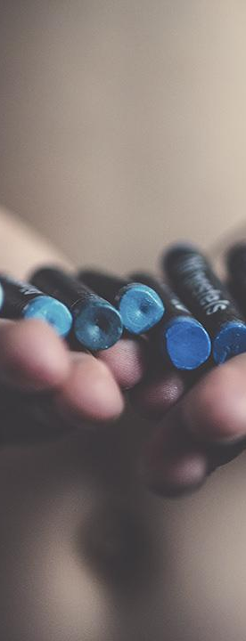
In two or three columns
Yellow
Is the color of gold, butter and ripe lemons. In the spectrum of visible light, yellow is found between green and orange.
Blue
Is the colour of the clear sky and the deep sea. It is located between violet and green on the optical spectrum.
Red
Is the color of blood, and because of this it has historically been associated with sacrifice, danger and courage.

